Slide 1
Innovation in US Graduate Schools: what makes it work and what makes it stick?
Debra Stewart Senior Fellow, NORC at the University of Chicago
President Emerita, Council of Graduate Schools
Council of Southern Graduate Schools Annual Meeting, February 18, 2022

Slide 2
Critical Junctures in Graduate Education
“What is imperative for the future success of our sector is that the forward-thinking colleges greatly outnumber the ones that try to return to business as usual…” Morton Shapiro, President of Northwestern, September 2021

Slide 3
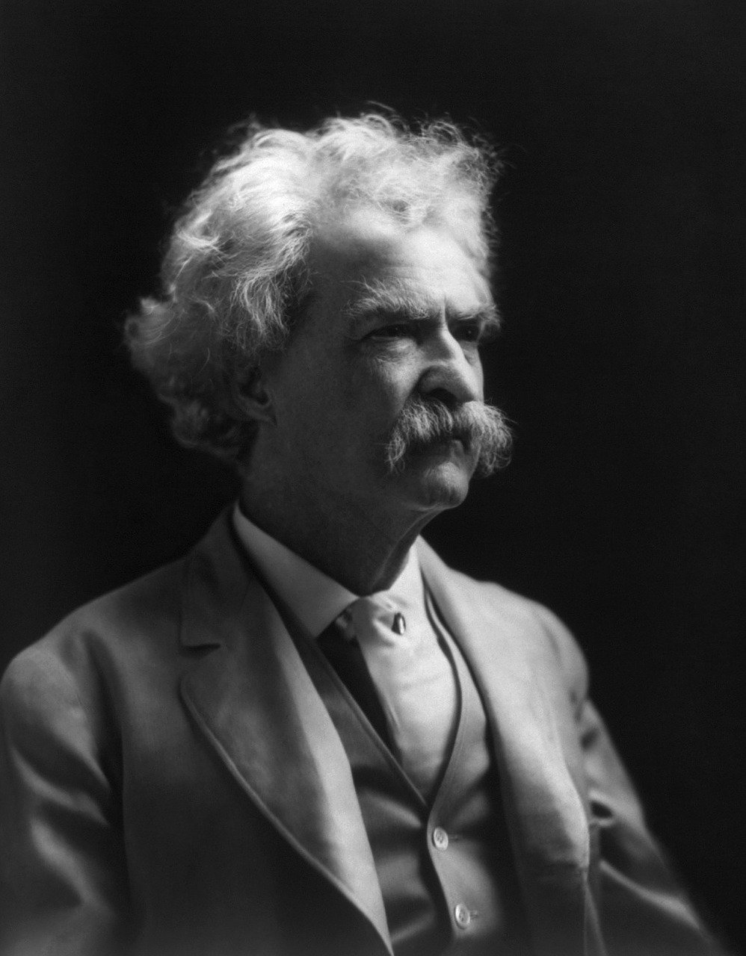
Critical Junctures
"It's not what you don't know that kills you, it's what you know for sure that ain't true.“ Mark Twain

Slide 4
Critical Junctures: Innovation Triggers
Urgency
Openness to change
Focus on what needs to be done

Slide 5
Overview of Methods
Survey: 300 Institutions Producing
Most STEM Graduate Degrees Stratified institutional sample - Doctoral - Masters-level - Historically Black Colleges &
Universities Individual sample
- The graduate school dean (or
individual in an analogous position)
Key topic areas - Student academic & research progress
- Student health & wellbeing - Program continuity & sustainability
Response rate – 70%
Virtual convening: 120 senior officials in graduate education and research
Discuss initial survey results and further understand impacts and innovations
Structured around six broad topics - Crisis Management and Program
Preservation: Things that Worked and
Opportunities for Improvement
- Academic and Research Continuity
- Student Health and Well-being
- Technological innovations
- Policy/process innovations - Sustaining innovation

Slide 6
Critical Junctures: Three Categories of Innovation
Contested/
Resolved
Uncontested
Unresolved

Slide 7
Critical Junctures: Uncontested Innovations
Streamline administrative practices
Zoom based/hybrid DGP meetings
Digital forms to document student progress
Virtual outreach to international applicants

Slide 8
Critical Junctures: Contested/resolved Innovation
Adoption of Whole File Review in admissions
Virtual orientations; virtual office hours
Virtual final dissertations defense standing option, if consensus
Priority on mental health and wellness

Slide 9
Critical Junctures: Unresolved Issues
Issues

Slide 10
Critical Junctures: Unresolved Issues
What proportion of the degree programs will be offered entirely online?
What does traditional “residency” mean in this context?

Slide 11
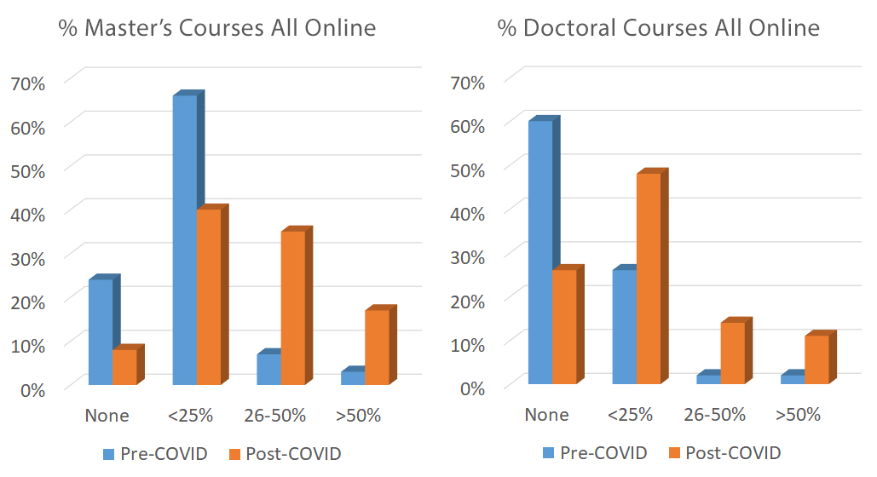
Going Virtual – The Shift to Online Learning
After the pandemic passes…
> 80% of institutions plan to expand online/hybrid graduate courses
> 50% of institutions plan to expand online/hybrid graduate programs

Slide 12
Critical Junctures: Unresolved Issues
What is the right mix of online, synchronous/asynchronous and self paced learning at the graduate level and what is the role of the graduate school in fostering innovation in the sphere?
What proportion of the degree programs will be offered entirely online? What does traditional “residency” mean in this context?

Slide 13
Critical Junctures: Unresolved Issues
How can mentoring be best conducted going forward. Should it be routinely virtual, routinely F2F, routinely blended?
What is the right mix of online, synchronous/asynchronous and self paced learning at the graduate level and what is the role of the graduate school in fostering innovation in the sphere?
What proportion of the degree programs will be offered entirely online? What does traditional “residency” mean in this context?

Slide 14
Critical Junctures: Unresolved Issues
What is the right mixture of F2F and virtual across critical aspects of research training?
How can mentoring be best conducted going forward. Should it be routinely virtual, routinely F2F, routinely blended?
What is the right mix of online, synchronous/asynchronous and self paced learning at the graduate level and what is the role of the graduate school in fostering innovation in the sphere?
What proportion of the degree programs will be offered entirely online? What does traditional “residency” mean in this context?

Slide 15
Critical Junctures: Unresolved Issues
How will the graduate school staff be managed going forward? Who can work virtually? What are the ground rules? And Why? What is the right mixture of F2F and virtual across critical aspects of research training?
How can mentoring be best conducted going forward. Should it be routinely virtual, routinely F2F, routinely blended?
What is the right mix of online, synchronous/asynchronous and self paced learning at the graduate level and what is the role of the graduate school in fostering innovation in the sphere?
What proportion of the degree programs will be offered entirely online? What does traditional “residency” mean in this context?

Slide 16
Critical Junctures: Unresolved Issues
How can graduate schools respond most effectively to the compelling calls for racial and social justice? How will the graduate school staff be managed going forward? Who can work virtually? What are the ground rules? And Why? What is the right mixture of F2Fand virtual across critical aspects of research training?
How can mentoring be best conducted going forward. Should it be routinely virtual, routinely F2F, routinely blended?
What is the right mix of online, synchronous/asynchronous and self paced learning at the graduate level and what is the role of the graduate school in fostering innovation in the sphere?
What proportion of the degree programs will be offered entirely online? What does traditional “residency” mean in this context?

Slide 17
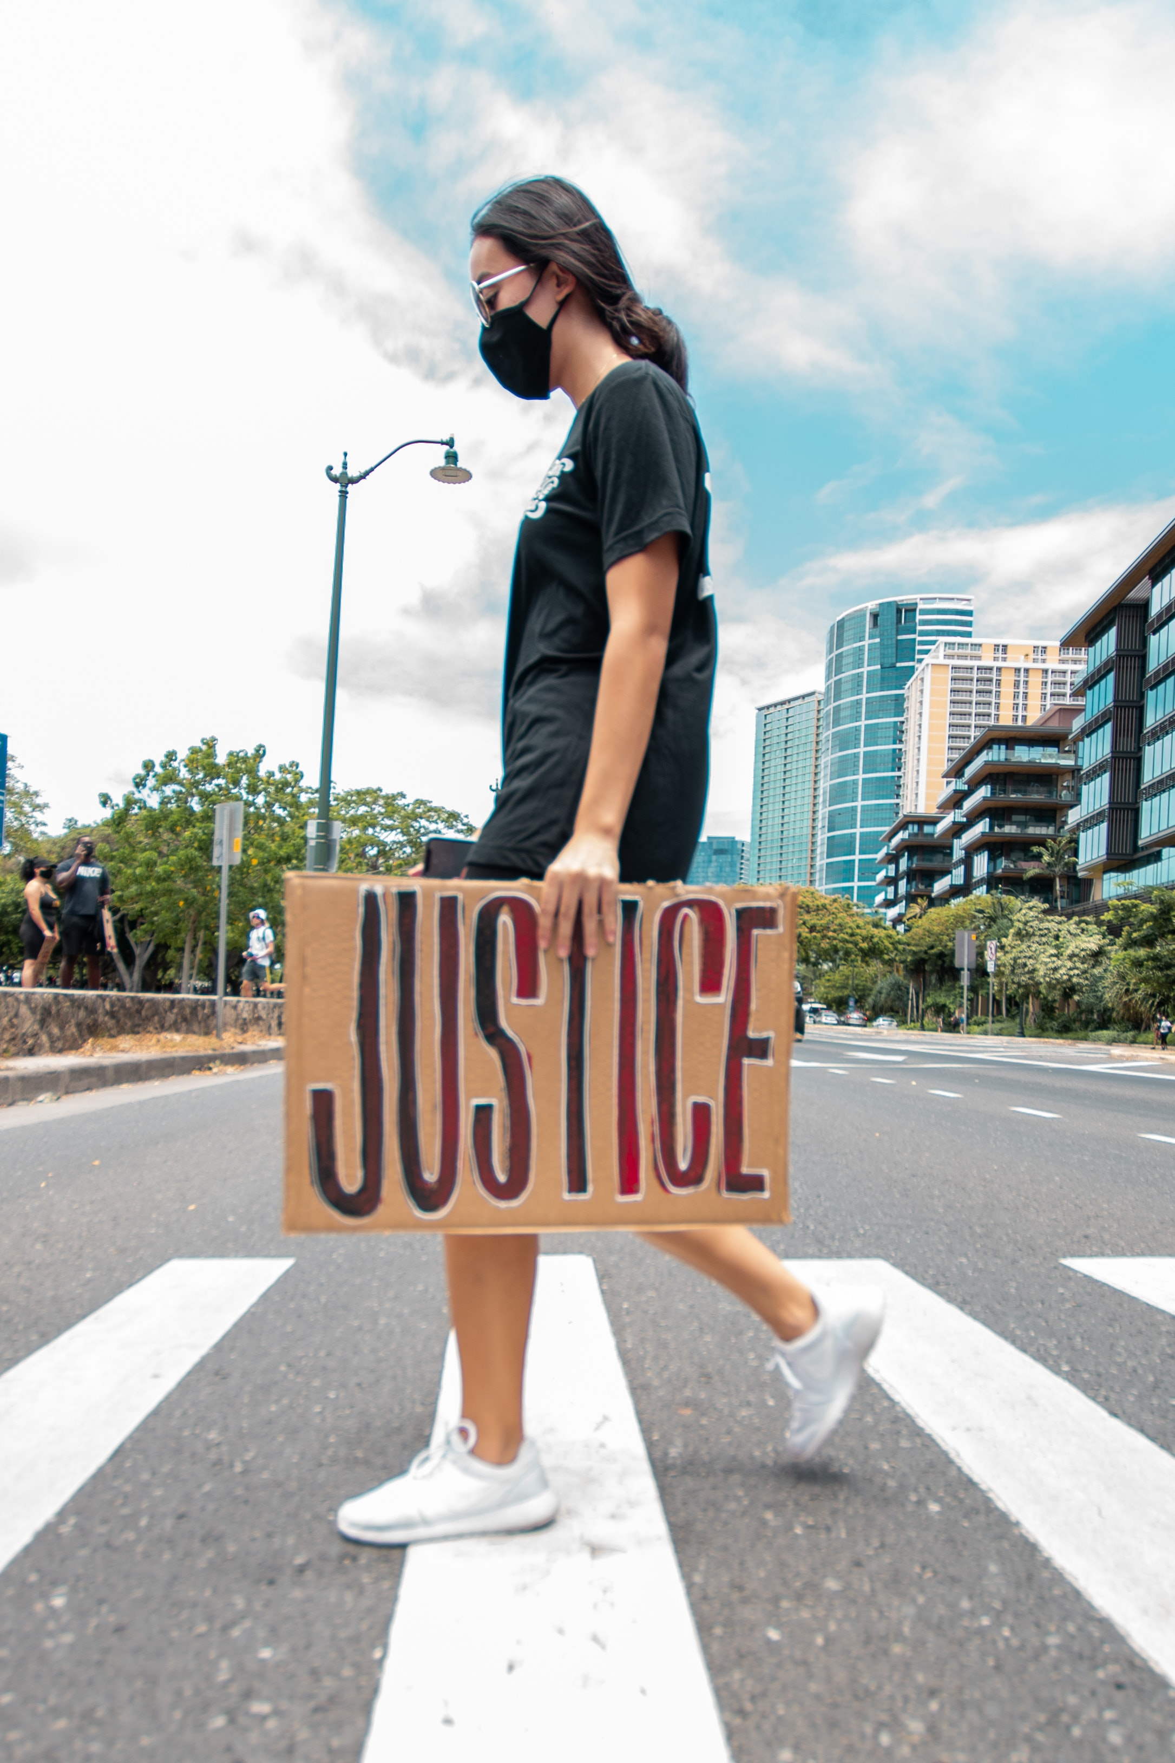
Critical Junctures: Unresolved Issues
The Voice of Graduate Deans:
“[T]he interaction of anti-Black racism, white privilege in graduate education, and the differential impact of COVID-19 by race, ethnicity, and socioeconomic status... is the major issue going forward in my view.” “Parallel with the impacts of COVID-19 has been a rise in awareness of social justice issues...I think that the impact of the latter on this campus and on STEM fields will be significant and perhaps obscure the effects of COVID.”

Slide 18
Critical Junctures: Unresolved Issues
How should the “intellectual space” of graduate education change around: how we educate graduate students, what questions are asked, how are they asked, and what answers are deemed legitimate? How can graduate schools respond most effectively to the compelling calls for racial and social justice? How will the graduate school staff be managed going forward? Who can work virtually? What are the ground rules? And Why? What is the right mixture of F2F and virtual across critical aspects of research training?
How can mentoring be best conducted going forward. Should it be routinely virtual, routinely F2F, routinely blended?
What is the right mix of online, synchronous/asynchronous and self paced learning at the graduate level and what is the role of the graduate school in fostering innovation in the sphere?
What proportion of the degree programs will be offered entirely online? What does traditional “residency” mean in this context?

Slide 19
Transforming the “Intellectual Space”
The combined impacts of COVID, renewed attention to racial and social justice, political instability, and debates about the role and place of scholarship and truth will shift:
What is being studied: Refocuses the subjects and topics of scientific inquiry; shift from “pure” to “public-facing” science; attention to impacts and effects
How it is being studied: need for interdisciplinary, emphasis on ethical and responsible research, shift to meta-analyses and other research using extant data
The communication and sharing of results: Ensure results and implications are clearly communicated and accessible to broad audiences via various platforms
The structure and delivery of graduate education itself: Decoupling courses and credentials from traditional Masters and Doctoral degree programs

Slide 20
Critical Junctures: Next Steps
“Innovation is always a balancing act of staying true to your vision and re-examining your assumptions.”
Innovation commentator, Greg Satell, 2021

Slide 21
Critical Junctures: Next Steps
The road forward, while not densely paved, will be heavily pebbled

Slide 22
Thank you.
Debra Stewart Senior Fellow Higher Education Analytics Center Stewart-Debra@norc.org
Acknowledgments and references:
I would like to acknowledge the research team engaged in producing the findings upon which this presentation is based. My NORC colleagues, Annie Davoren, Erin Knepler, and Jim Neumeister, were all significant collaborators in designing, fielding, and analyzing the survey conducted in the summer of 2020 and in the convening in the fall of 2020. Erin Knepler and Jim Neumeister both participated in the numerous presentations and discussions after the original data gathering that enriched our understanding of the “stickiness” of the innovations discussed. Please refer to the project webpage for full documentation of the research. https://www.norc.org/Research/Projects/Pages/ensuring-the-success-of-stem-graduate-students-and-research-programs-during-the-covid-19-crisis.aspx

