Slide 1
Improving STEM Communication Among Graduate Students
Dr. Jill Huerta
Dr. Aura Young
Conference of Southern Graduate Schools
Annual Meeting 2022

Slide 2
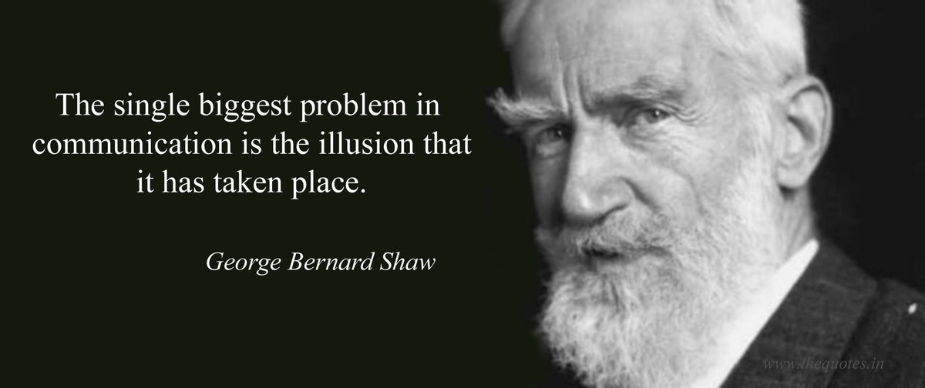

Slide 3
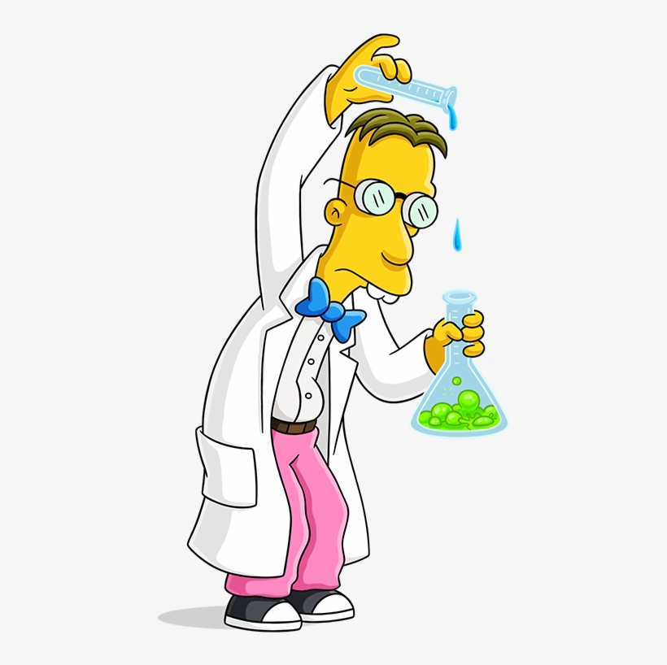
The Problem:
STEM scholars are bad communicators
It’s not just a stereotype, folks!

Slide 4
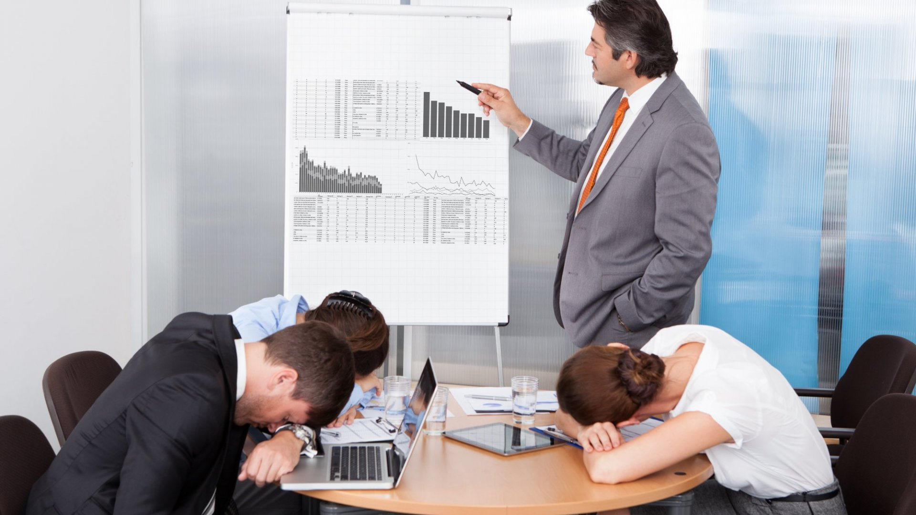
People spend years working toward their degree,
yet can’t put together a decent presentation or explain to their grandma what they do.
Why?

Slide 5
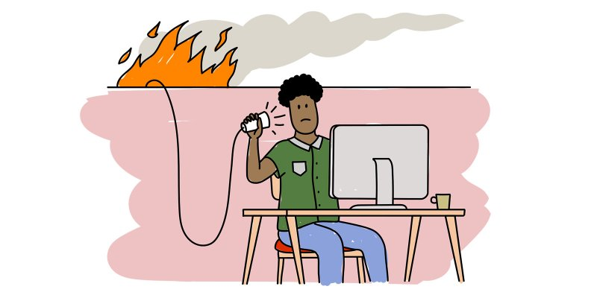
What happens when we graduate scholars who are terrible communicators?

Slide 6
Our Solution:
Sought funding:
Career Guidance for Trainees Grant
Found speakers and coaches
Recruited STEM Fellows
Workshop series
Coaching
Deliverables
Assessment

Slide 7
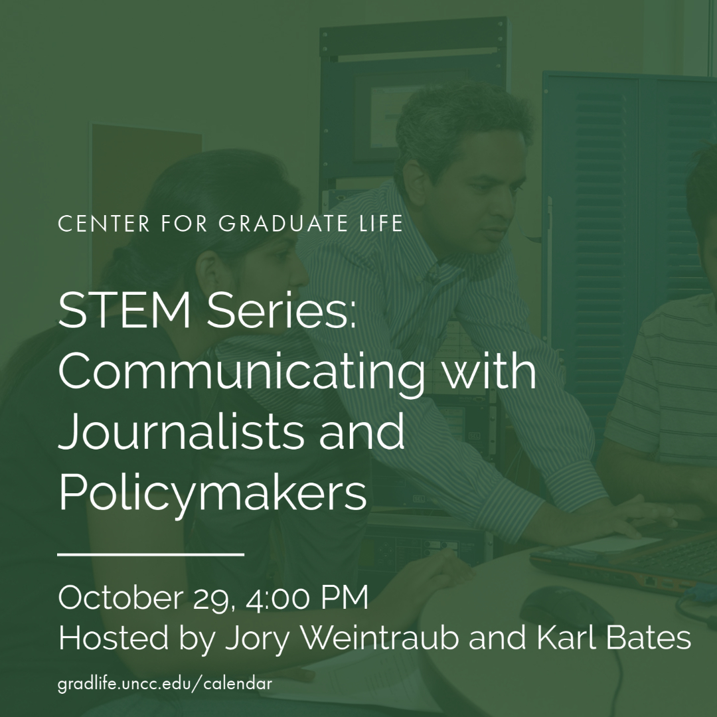
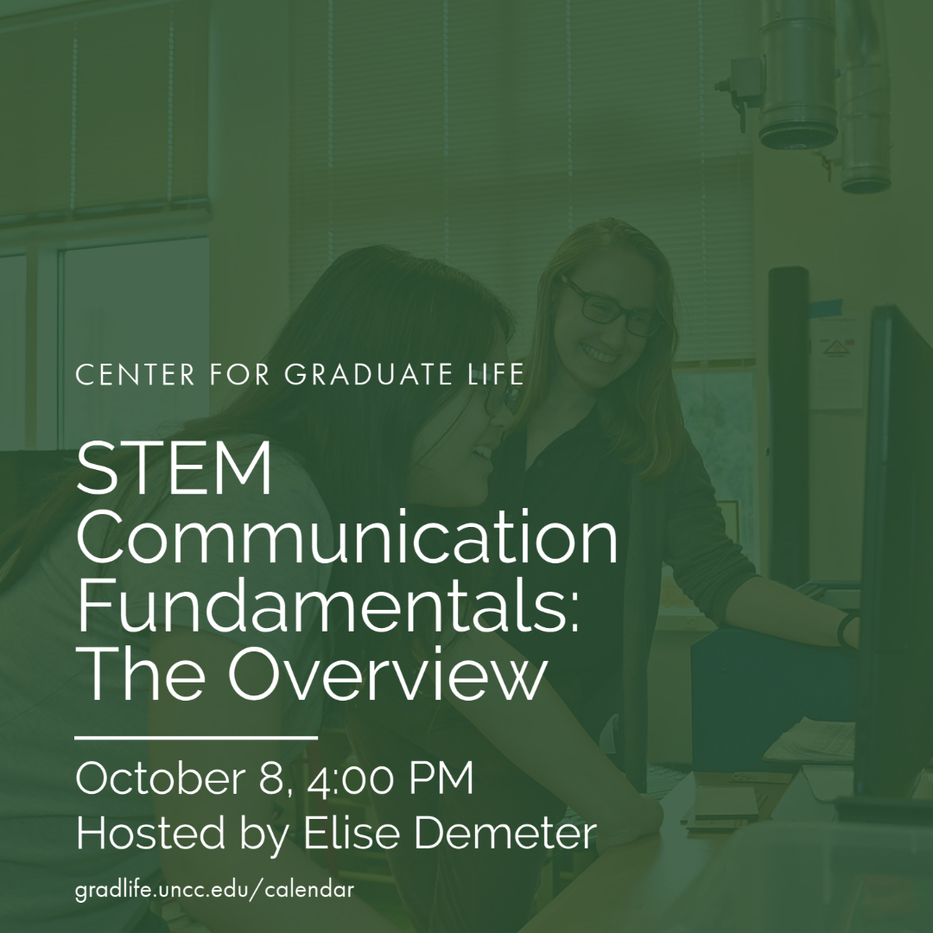
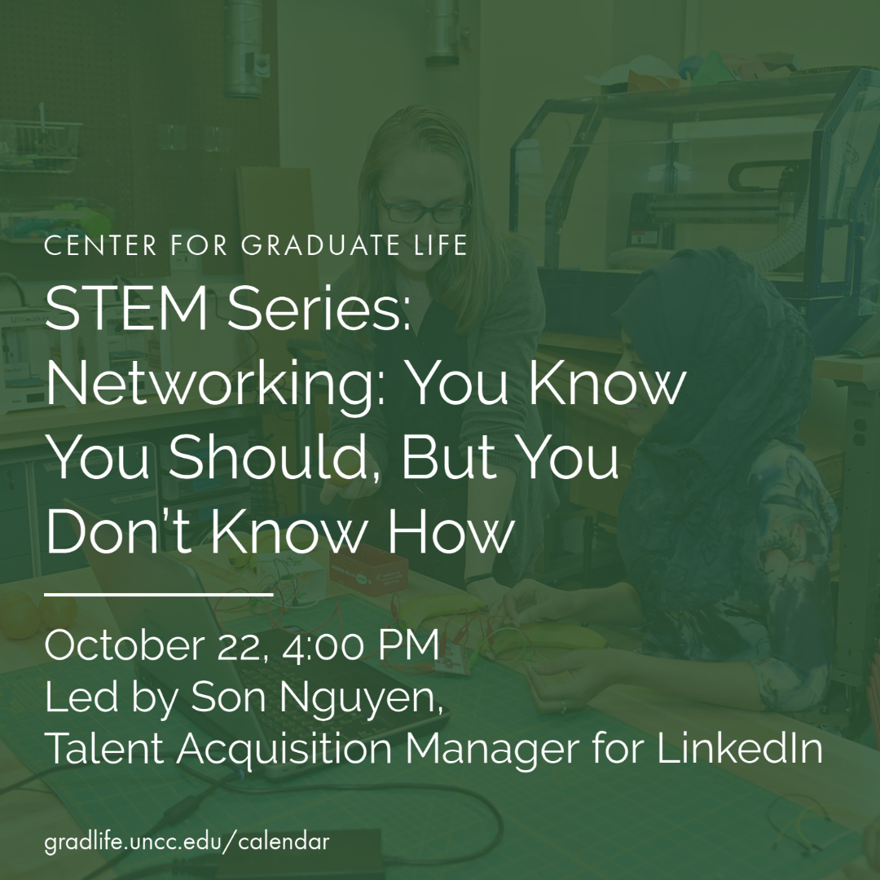

Slide 8
2020-2021 STEM Communication Workshop Series
STEM Communication Fundamentals: The Overview
Preparing for an International STEM Experience: How to Communicate Across Borders
Networking: You Know You Should, But You Don’t Know How
Communicating with Journalists and Policymakers
STEM Communication Series: Conveying Research through Social Media
How to Speak Corporate: Essential Corporate Communication Skills
Communicating with Many Audiences Through Writing
Collaborating with Diverse Teammates: How to Communicate with Cultural Intelligence
How to Write About Research for the Public

Slide 9
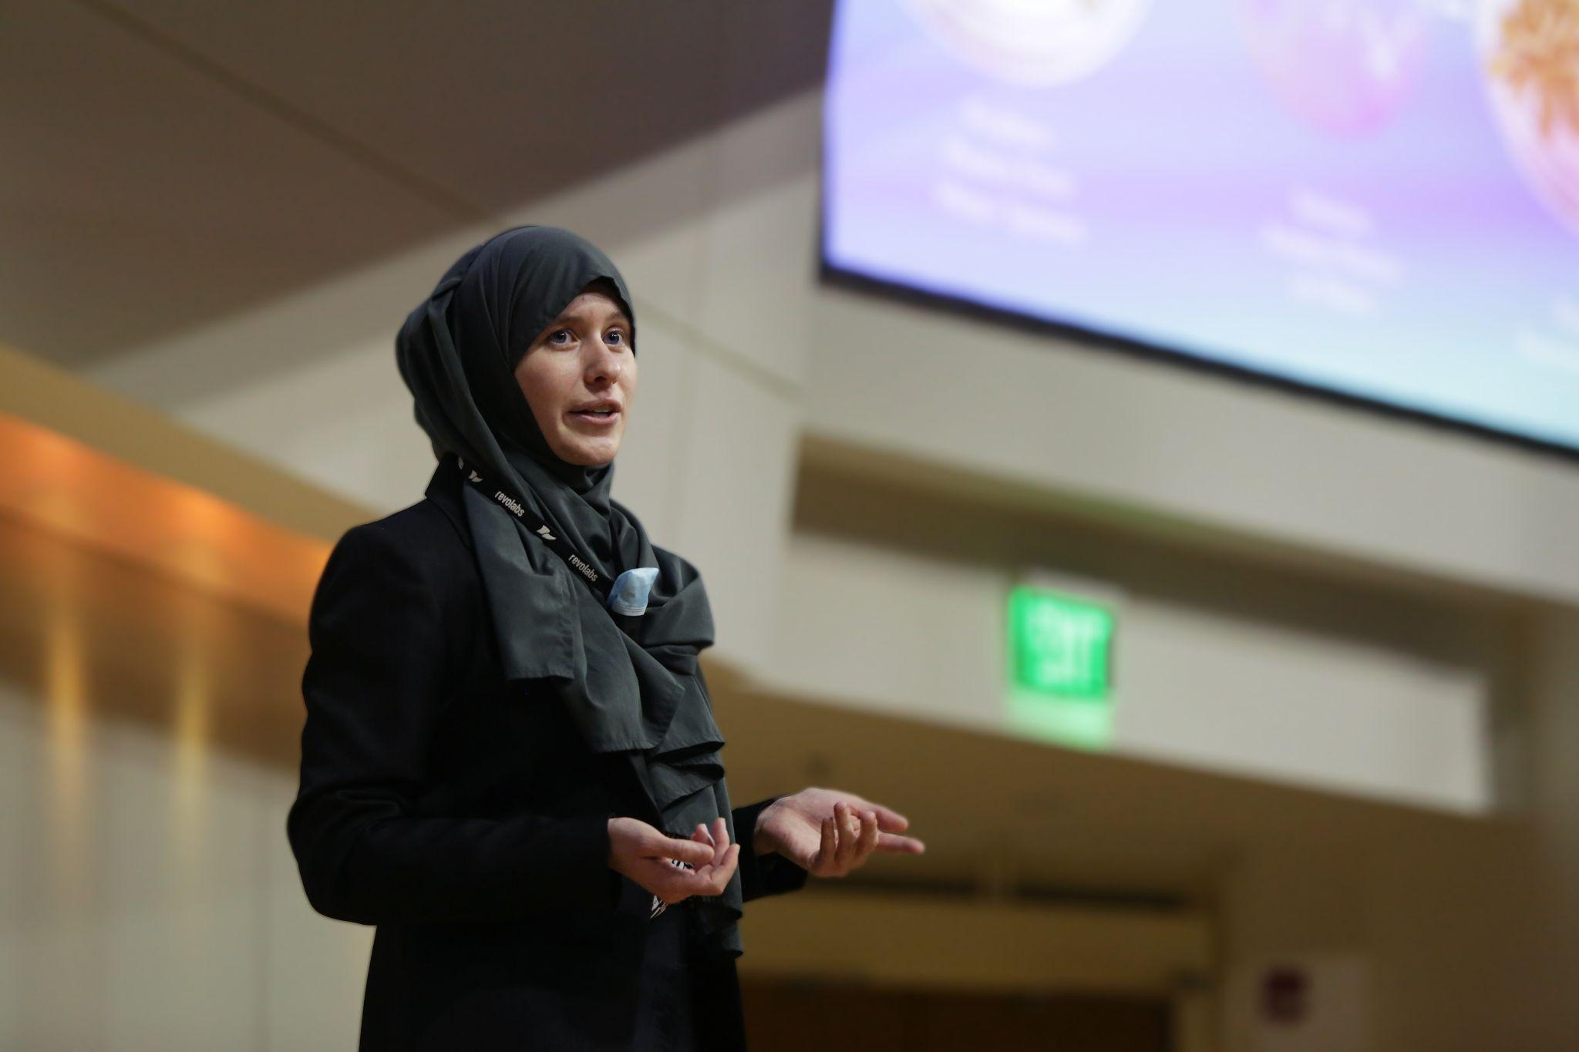
Results

Slide 10
Results

Slide 11
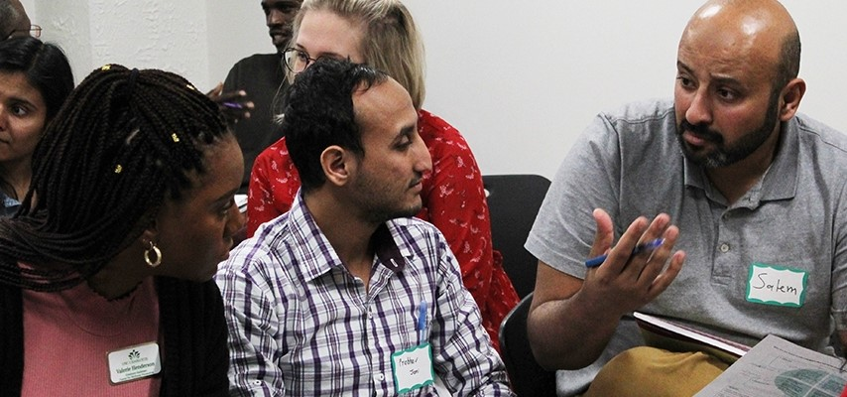
Our Recommendations

Slide 12
What is your institution doing to support scicomm training?

Slide 13
Thank you!
jhuerta2@uncc.edu | https://www.linkedin.com/in/jill-huerta-ph-d-b6aa5952
aura.young@uncc.edu | linkedin.com/in/aurayoung/

