Slide 1
Strategic Networking: How you can actually enjoy building your brand
Dr. Jill Huerta, UNC Charlotte
Conference of Southern Graduate Schools
Annual Meeting 2022

Slide 2
Principle 1:
Networking is a long game

Slide 3
Principle 2:
Network with good intentions

Slide 4
Principle 3:
Find common ground

Slide 5
Principle 4:
Be authentic and share your story

Slide 6
Principle 5:
Always be professional

Slide 7
Principle 6:
Refer back to Principle 1:
Networking is a long game

Slide 8
Remote Networking
Notes:
This includes social media platforms, and email communications.

Slide 9
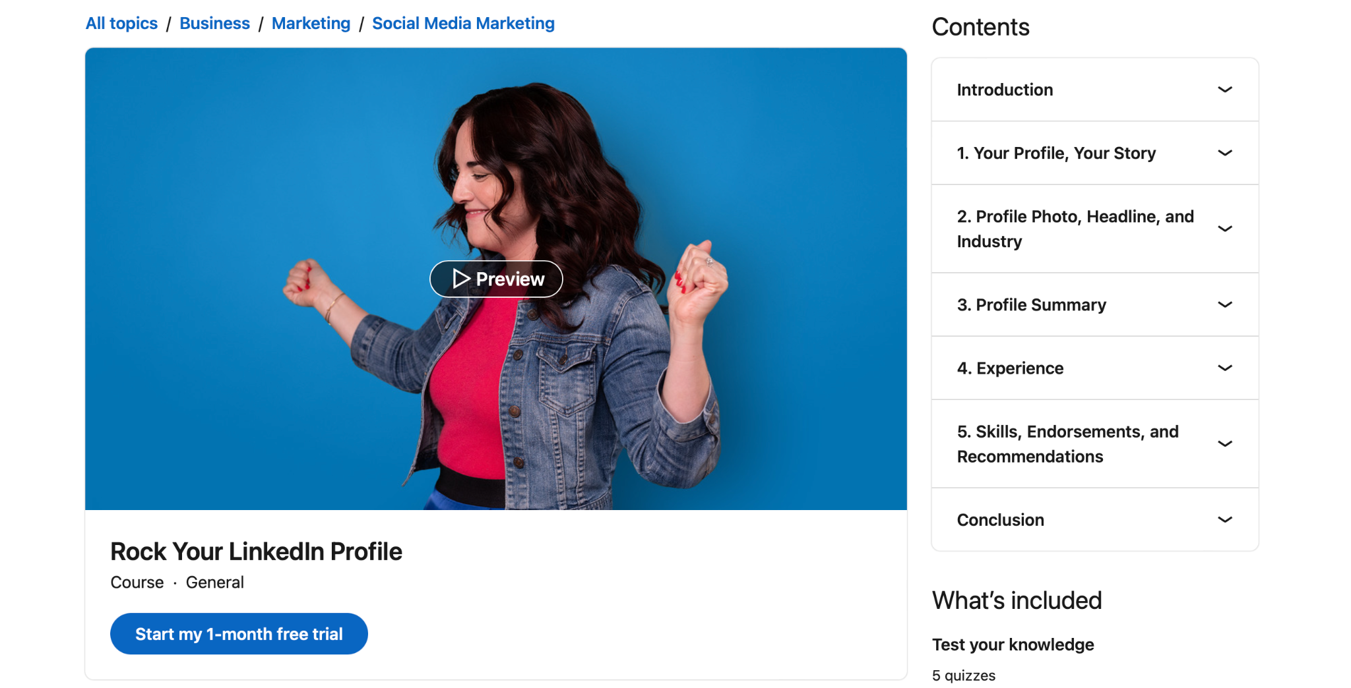

Slide 10
Engaging With Your Network
Post About:
Your research
Takeaways from conferences, classes, or training
Videos and projects you produce
Ask for feedback
Celebrate the efforts of others and tag them.

Slide 11
Remember Principle 1:
Networking is a long game

Slide 12
Networking in Person

Slide 13
Practice, Practice, Practice

Slide 14
Prepare, Prepare, Prepare
Backgrounds of people you’re likely to meet
Cultural norms
Dress appropriately
Body Language

Slide 15
Remember Principle 1:
Networking is a long game

Slide 16
Questions

